Slide 1
Intro to AI in Medicine
Lec 7: Case Studies

Slide 2


Slide 3
Last Time
Discussed various AI networks and their use cases
RNN/LSTM
Autoencoder
GAN
Mentioned Random Forest methods

Slide 4
By This Point…
You know the basics of AI
Data
Loss
Network
Training
You know how to break down and interpret how AI systems work, even ones you don’t know about

Slide 5

Today
4 case studies
How do you take a paper and understand what’s going on

Slide 6
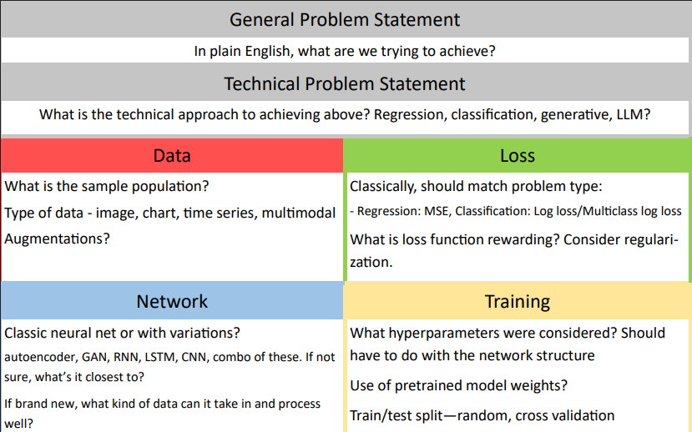

Slide 7
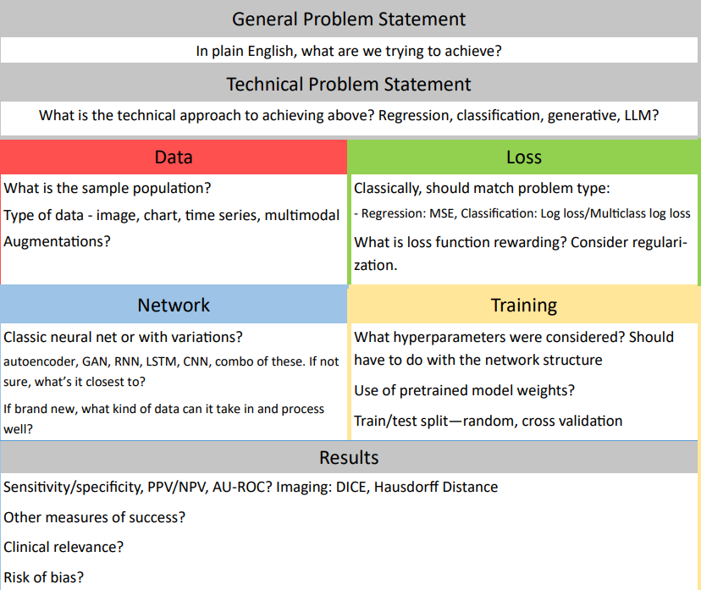
Notes:
Maybe subject to change

Slide 8


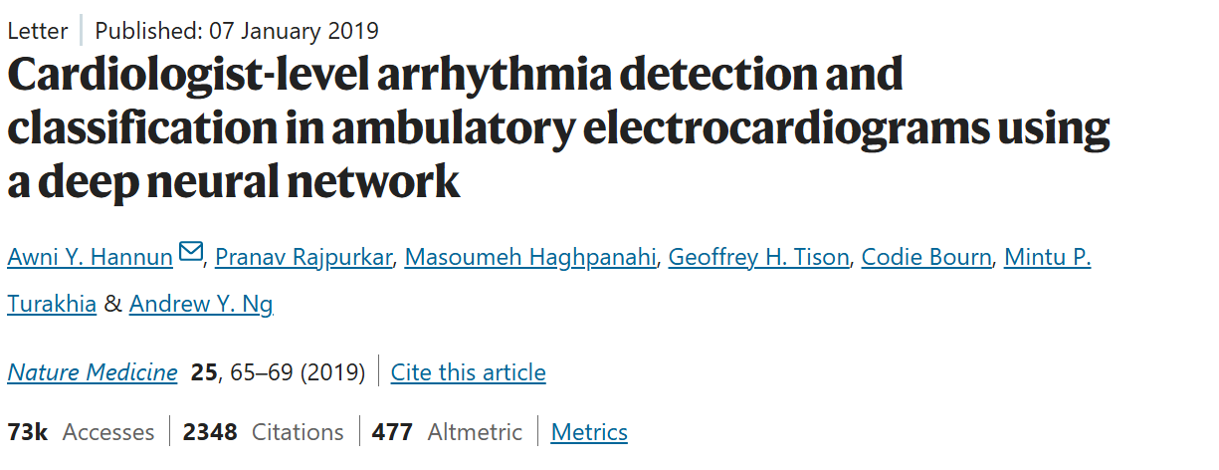
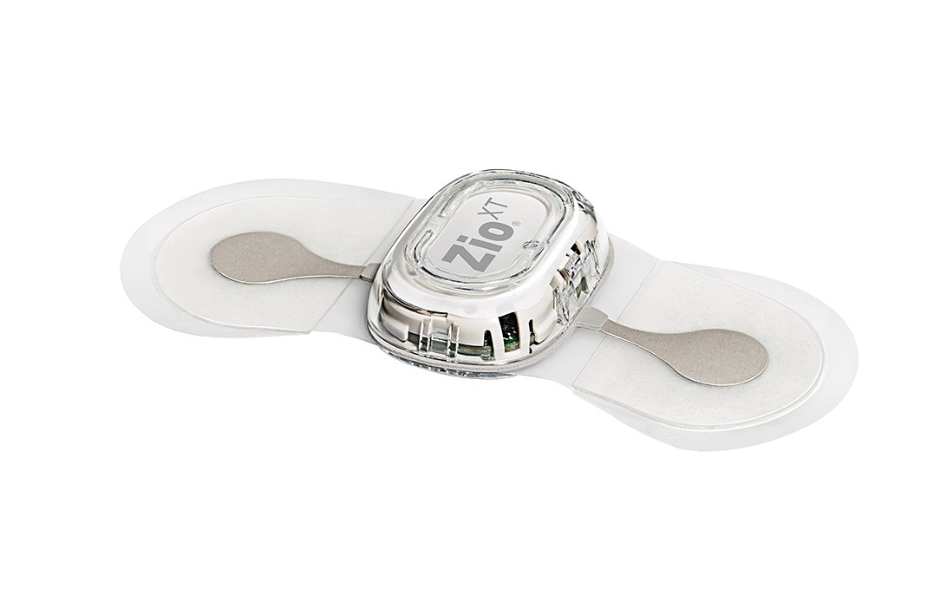
Case Study 1
https://www.nature.com/articles/s41591-018-0268-3
Notes:
>3k citations
Stanford and UCSF based team
iRhythm Zio Patch
https://www.nature.com/articles/s41591-018-0268-3

Slide 9
General Problem Statement
Classify ZioPatch readings into one of many types of arrhythmia
Technical Problem Statement
Multiclass classification of EKG images into classes using convolutional/DNN
Data | Loss
91,232 single-lead ECGs from 53,549 patients Annotation of ground truth by cardiologists The atrial fibrillation class combined atrial fibrillation and atrial flutter. The AVB class combined both type 2 second-degree AVB (Mobitz II/Hay) and third-degree AVB. | Rhythm predictions every 1.28 seconds Compared ground truth and algorithm at every 1.28 second interval, as well as diagnoses across whole recording time
Network | Training
Convolutional DNN, which decreases dimensionality layer after layer Batch norm, ReLU activation, Dropout | Held out records from a random 10% of the training dataset patients for use as a development dataset to perform DNN hyper-parameter tuning. Cardiologist data was test, else train was by annotator
Notes:
Data approach vs image approach

Slide 10
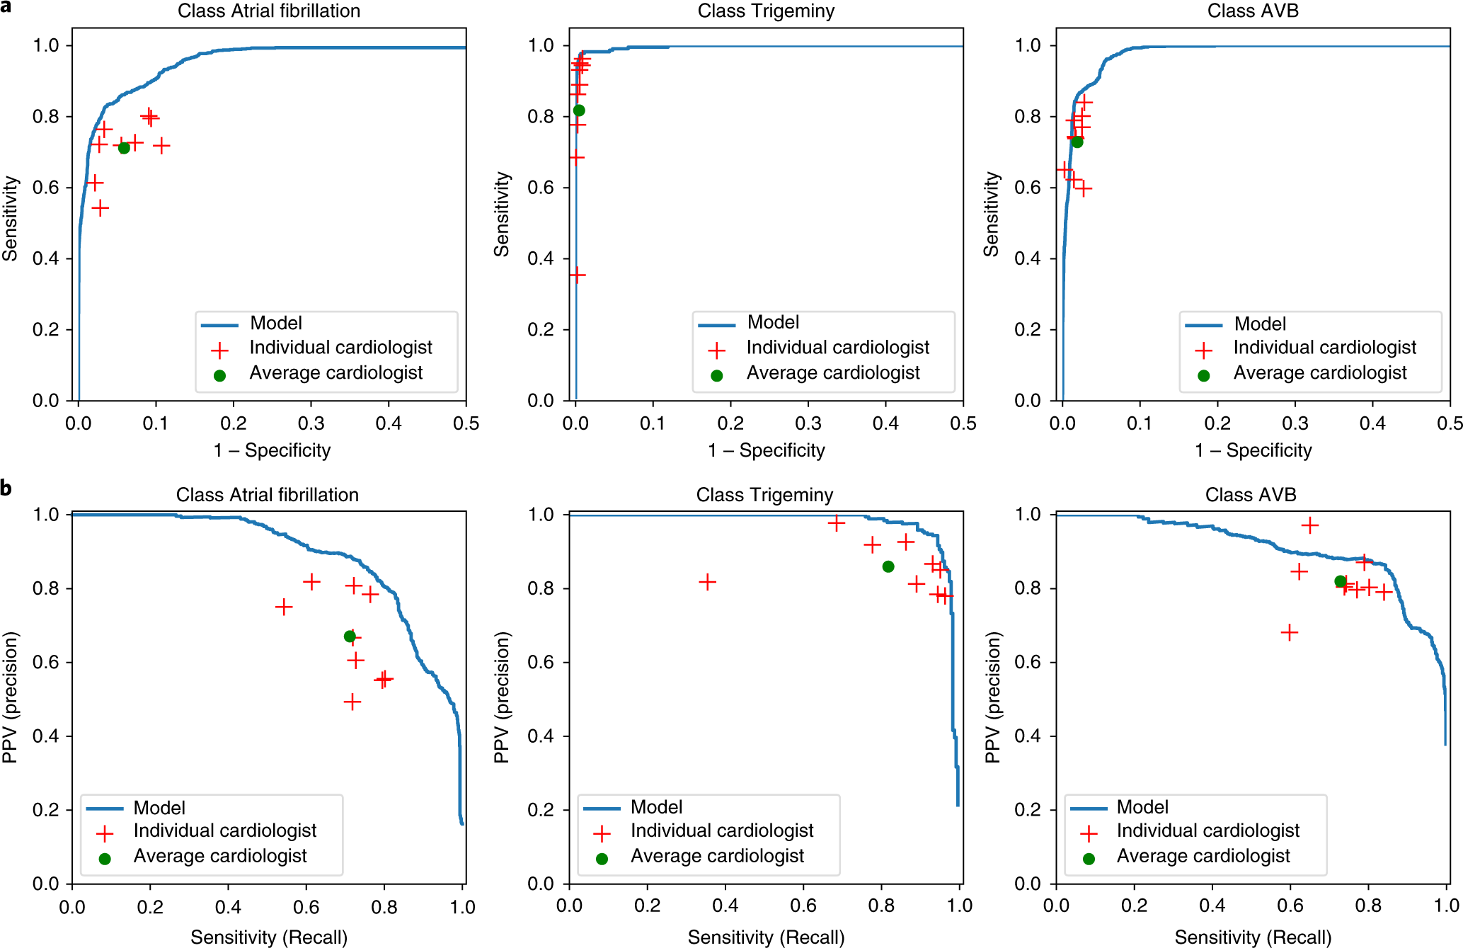
Notes:
Are these good? Participation
Outperformed individual cardiologists for these classes
At the same sensitivity, more specific & vice versa

Slide 11
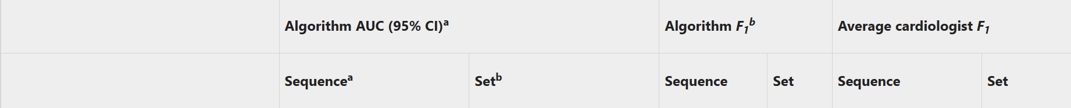
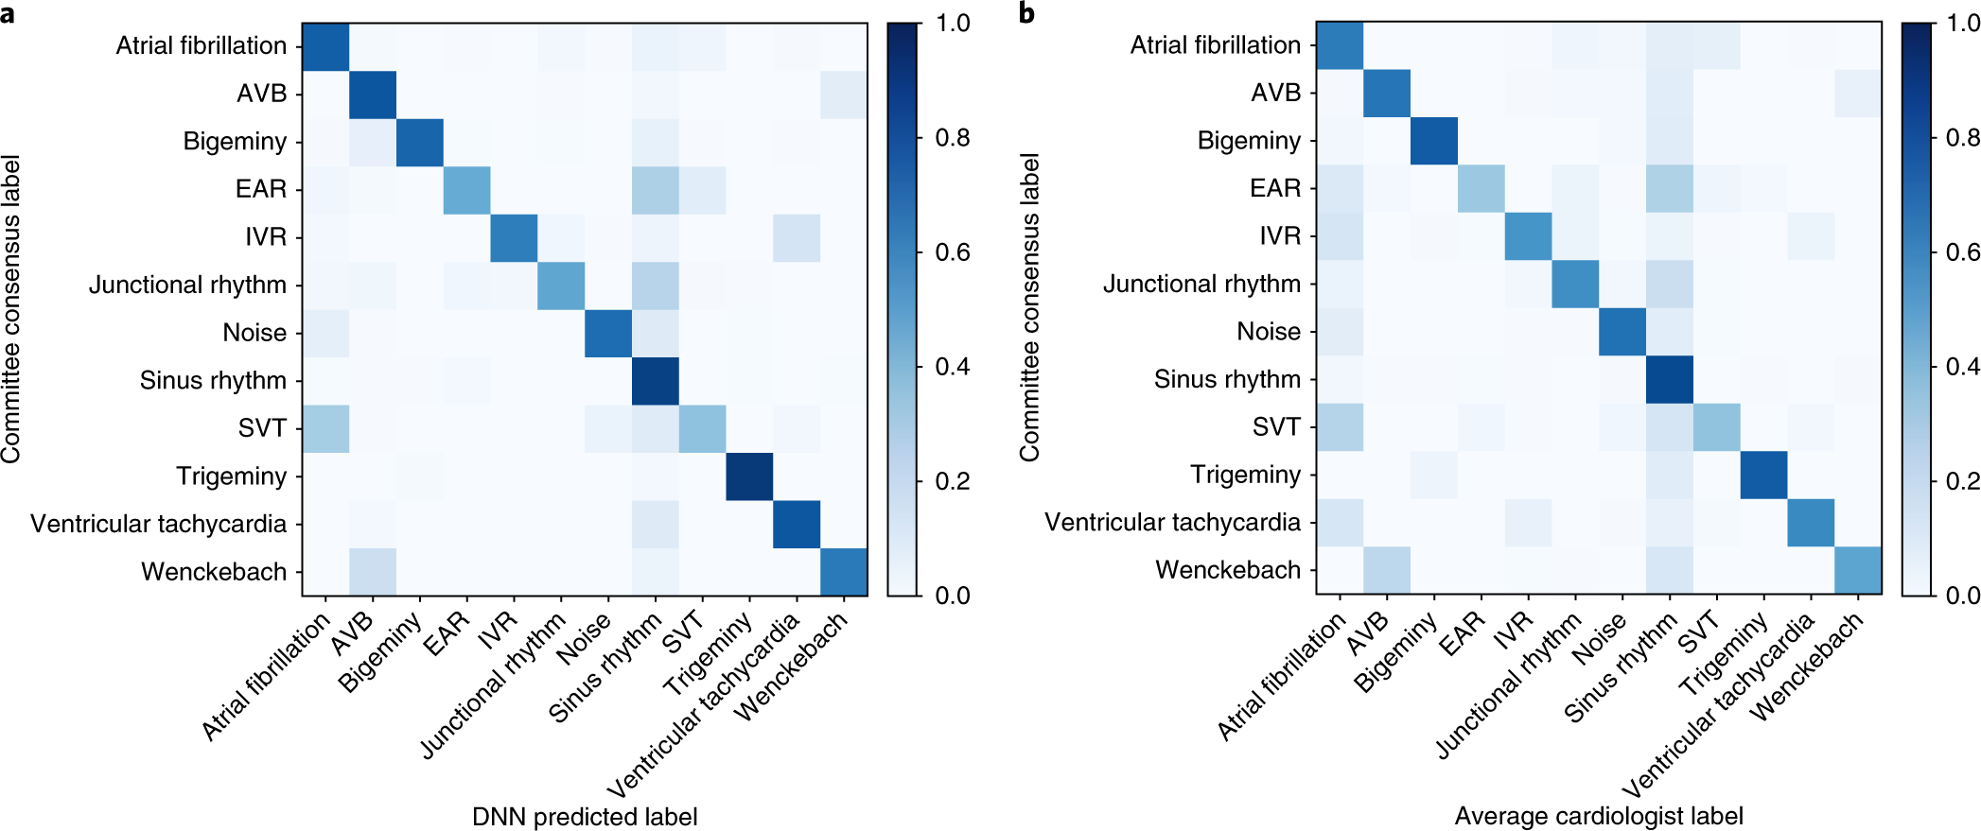
Notes:
Confusion matrix

Slide 12
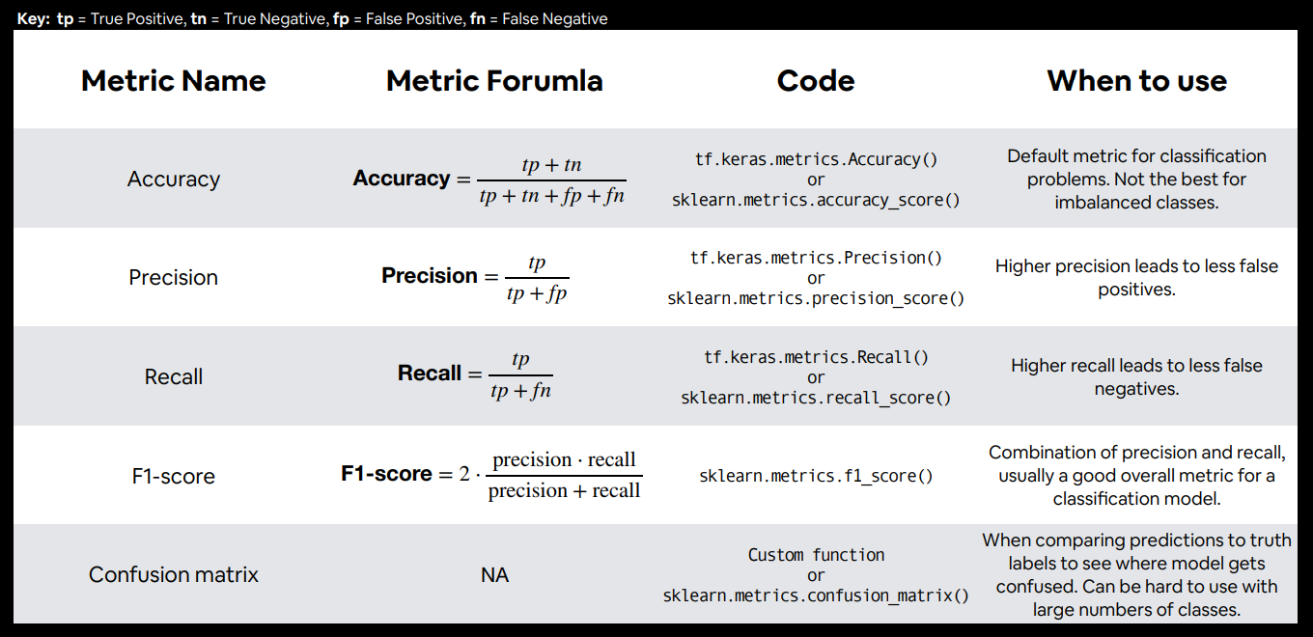
PPV
Sensitivity

Slide 13
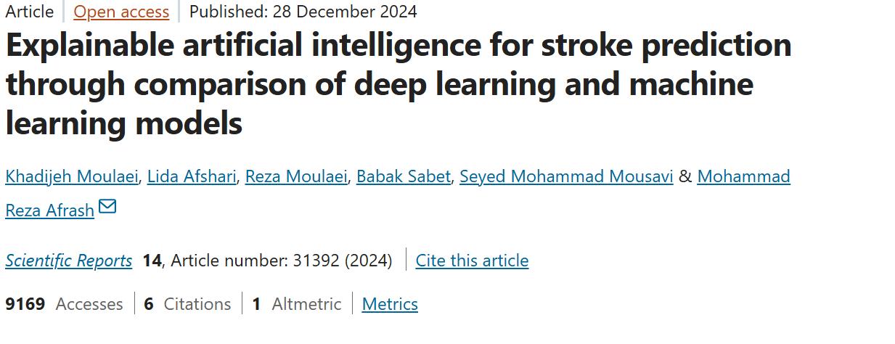
Case Study 2
https://www.nature.com/articles/s41598-024-82931-5#Sec11
Notes:
Much less cited, much newer

Slide 14
General Problem Statement
Predict if a patient will have a stroke
Technical Problem Statement
Classification task using multiple models
Data | Loss
Dataset comprising 663 records from one Iranian hospital 401 cases, 262 controls Predicting stroke in what timeframe? Unclear 53 important features influencing stroke in patients were identified by two neurologists. Variables with missingness less than 30% were imputed, | Varies based on network
Network | Training
A total of eight established ML (SVM, XGB, KNN, RF) and DL (DNN, FNN, LSTM?, CNN?) models were utilized to predict stroke. | 10-fold cross-validation approach
Notes:
Why not use every feature?
CNN with tabular data?

Slide 15
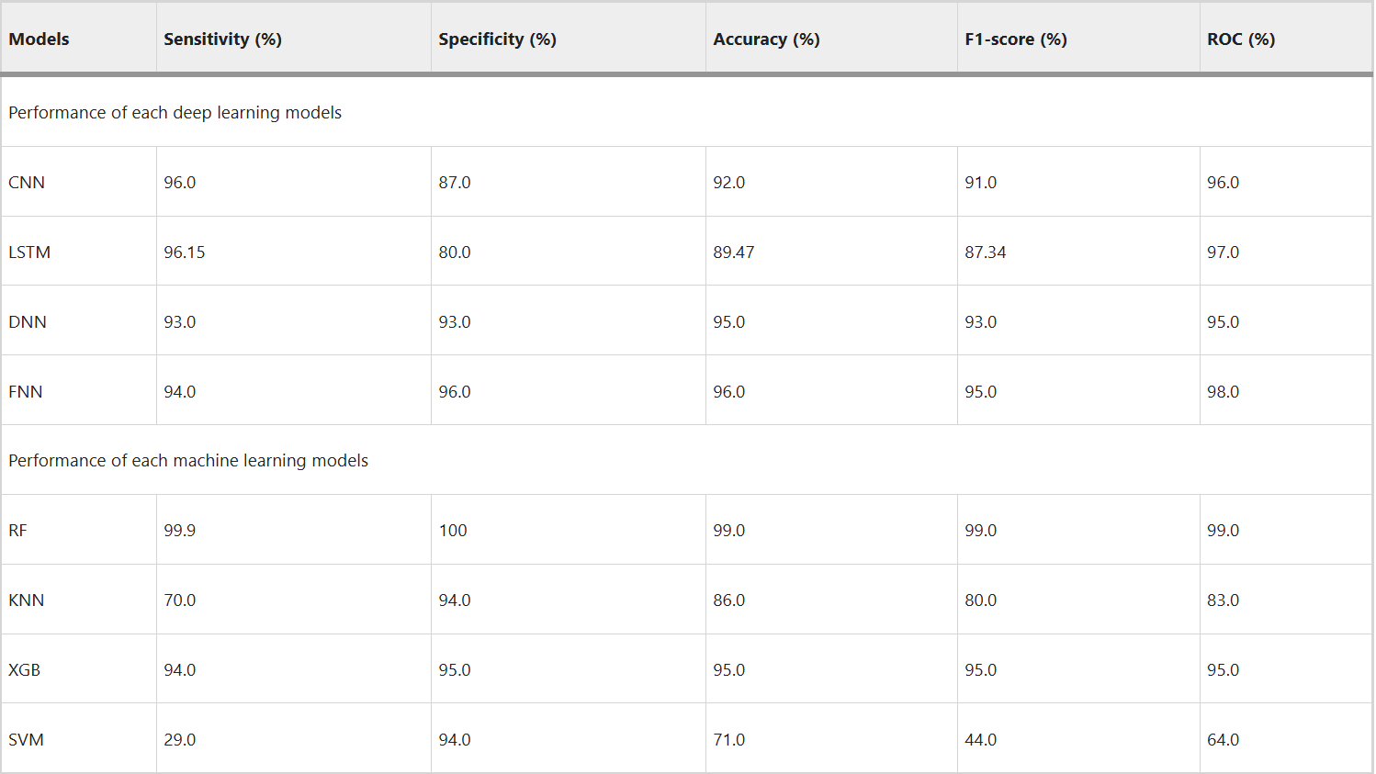
Notes:
FNN: Feedforward
DNN: Many layers
RF: Random forest
Question overfitting

Slide 16
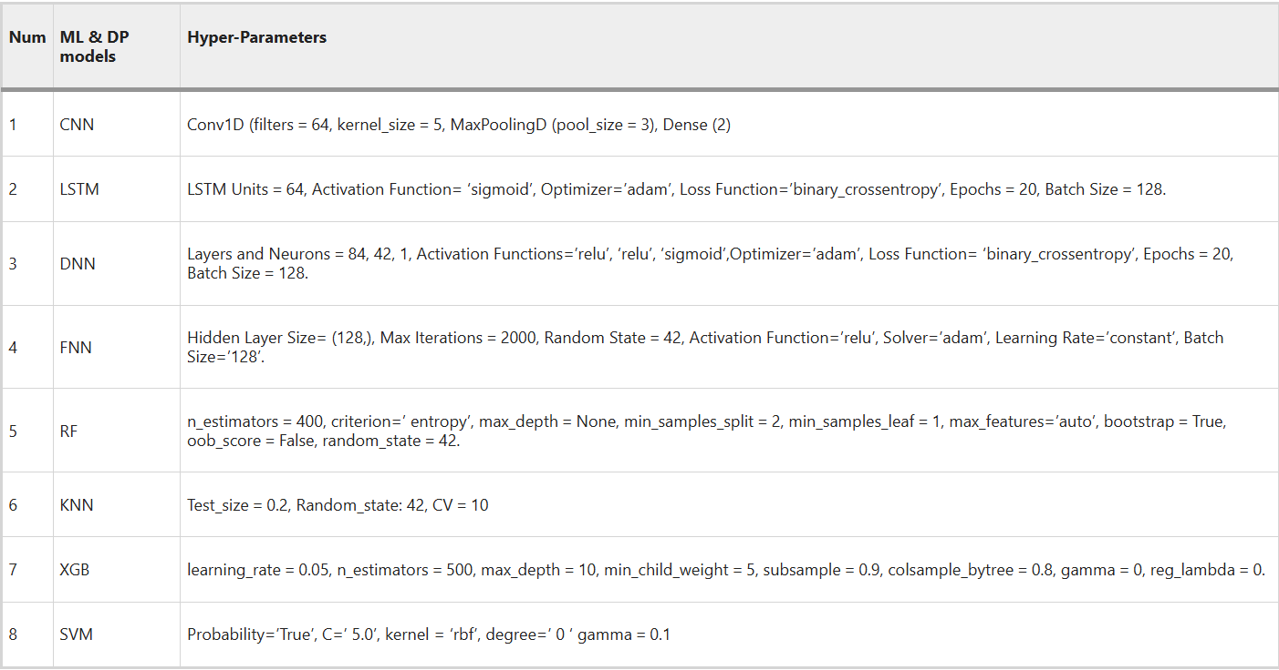

Slide 17
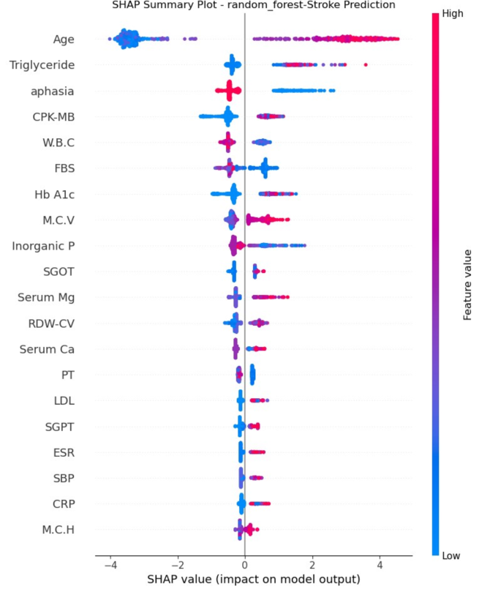

Slide 18
Takeaway
Promising paper, but needs to be repeated
“Too good to be true” esp. in the context of authors making questionable network decisions

Slide 19
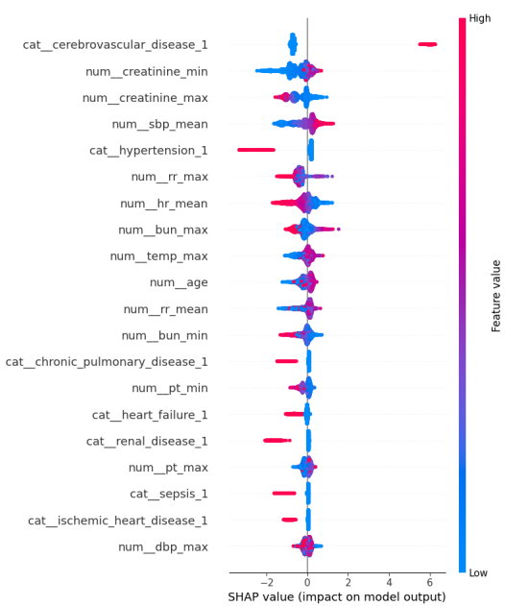
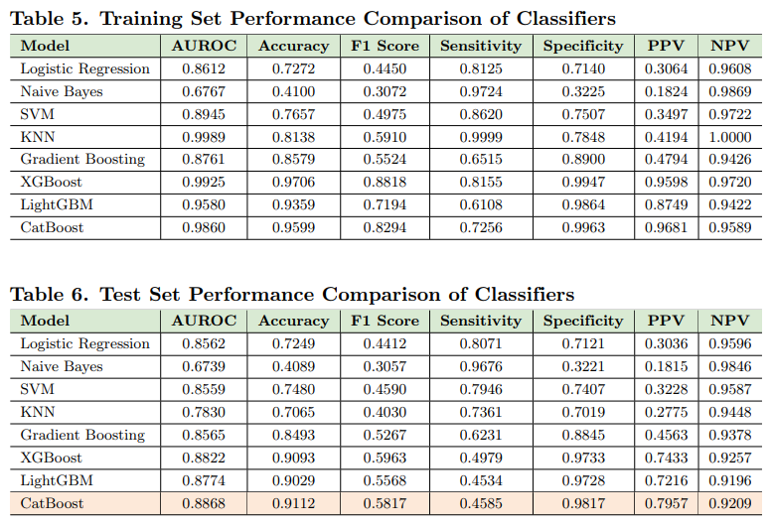
From another paper
https://arxiv.org/pdf/2506.03209
Notes:
Much more realistic values
Creatinine… indicator of renovascular disease -> HTN
Always be thinking about how it could make sense

Slide 20

Case Study 3

Slide 21
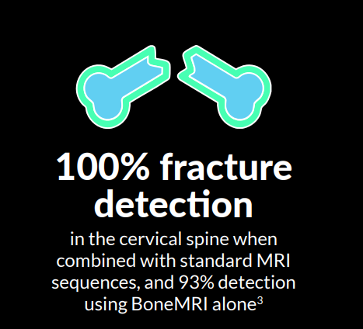
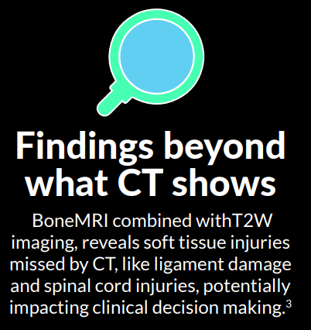
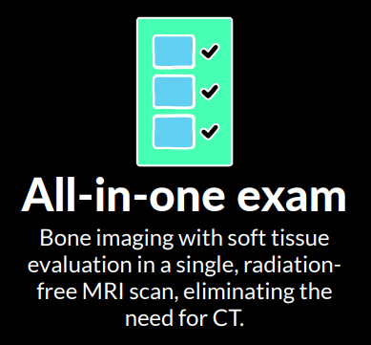

Claims
https://mriguidance.com/wp-content/uploads/2025/07/Fractures-one-pager.pdf

Slide 22
Business Pros/Cons

Slide 23
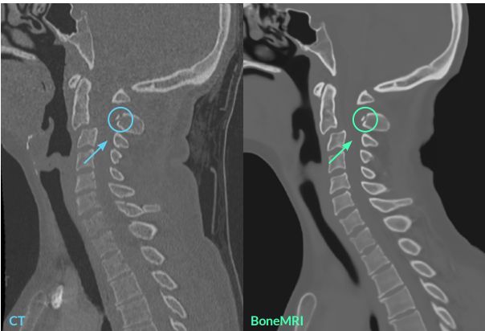
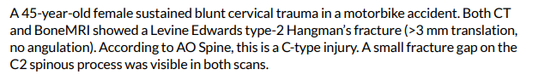

Slide 24
General Problem Statement
Generate an anatomically and visually accurate synthetic CT from an MRI
Technical Problem Statement
Voxel-wise regression of MRI intensities to CT intensities (Hounsfield units)
Data | Loss
MRI (many phases overlaid) + CT 18-80 traumatic C-spine @ 2 hospitals w/o contraindication Ground truth for fracture determined by 3x spine surgeons, 2x radiologists | The similarity between the CT and sCT was assessed using 5 metrics: mean error (ME), mean absolute error (MAE), Dice similarity coefficient (DSC), surface distance, and peak SNR L1 regularization (lasso) (emphasizing sparse network)
Network | Training
Next slide | 3-fold cross-validation approach Pre-training registration (alignment)
Notes:
Lasso determined empirically

Slide 25
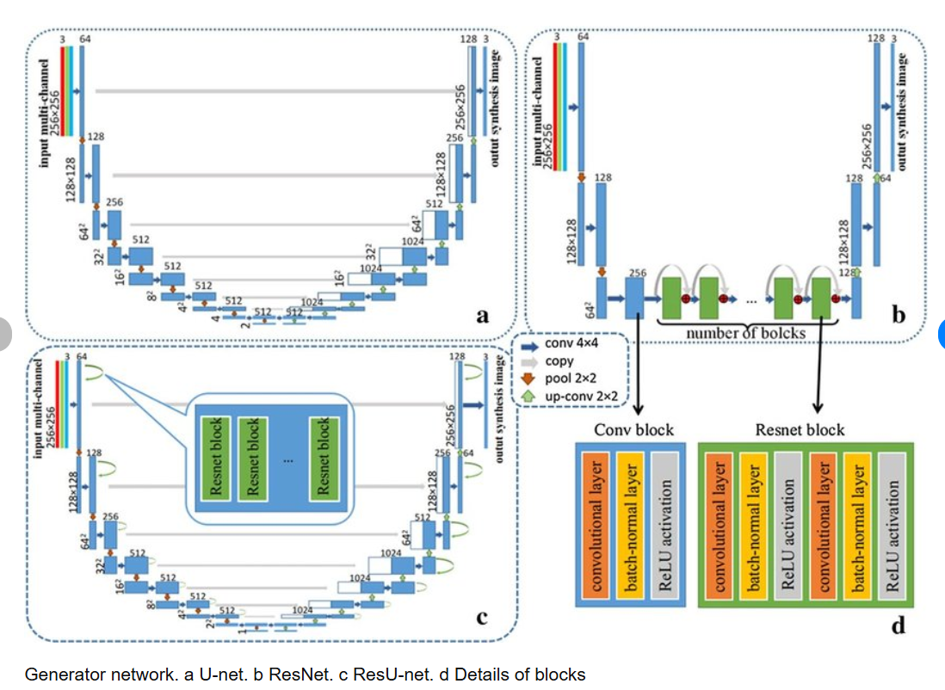
Visual autoencoder known as a U-net

Slide 26
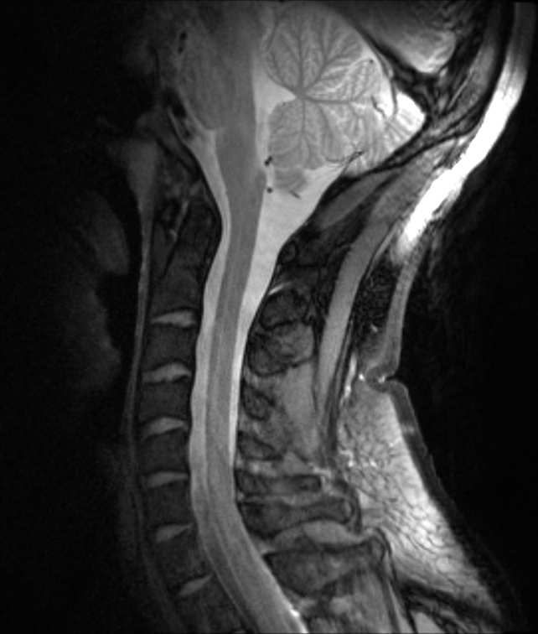
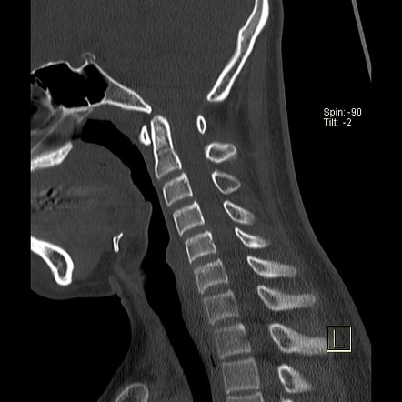
Input
Output
Height
Sequences
Width
Width
Notes:
H x w x s input,
H x w x 1 output

Slide 27
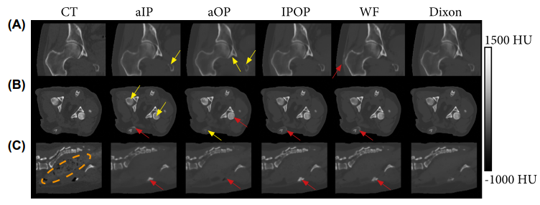
Multi Sequence Input Is Critical
Notes:
https://onlinelibrary.wiley.com/doi/pdf/10.1002/mrm.28008
18–20 min acquisition time

Slide 28
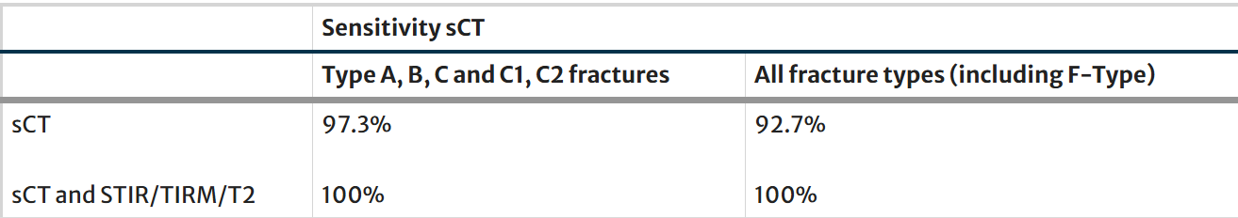
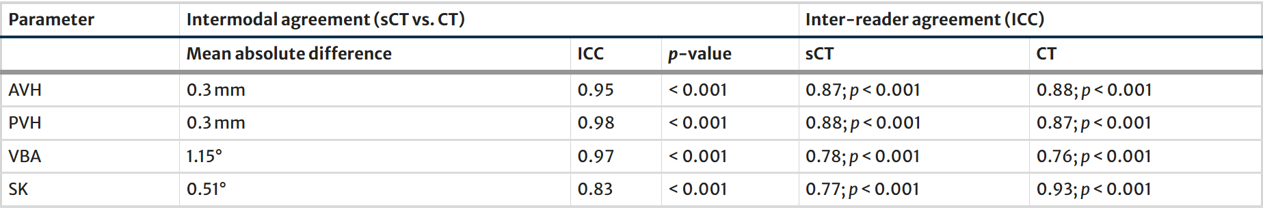
Results
Notes:
Perfect when considering sCT + all sequences
Interestingly MR alone not included – what if that’s enough

Slide 29
Who should buy this technology?

Slide 30
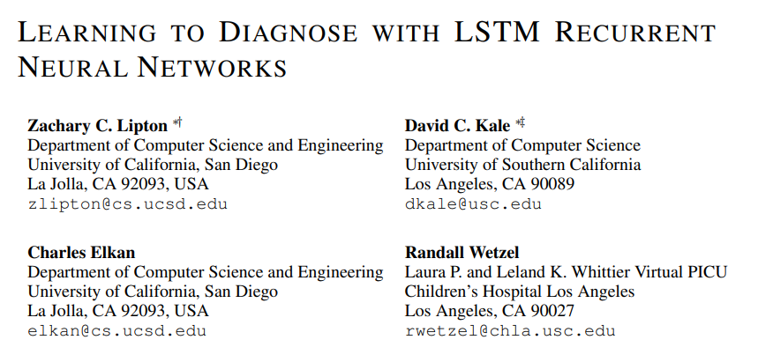
Case Study 4
Notes:
1600+ citations, older, from 2016
Introduced last lecture
Time series p

Slide 31
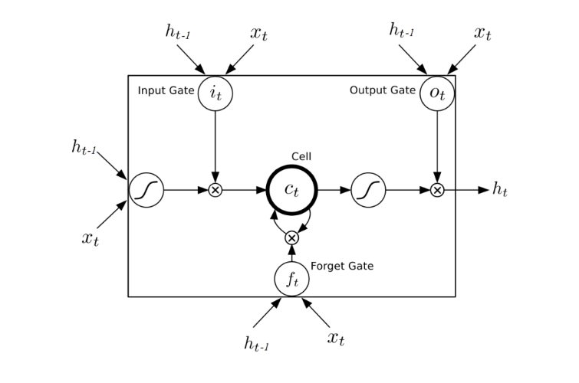
Long Short Term Memory
Notes:
Extension of RNN to include a forget gate, preventing certain data from propagating
Bc of that only critical info makes it thru, so addresses the issue of data being a smaller and smaller piece of the state
Used commonly for most tasks.

Slide 32
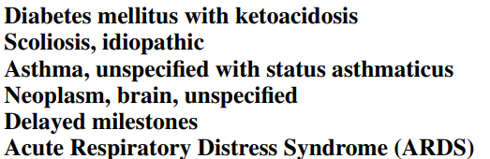
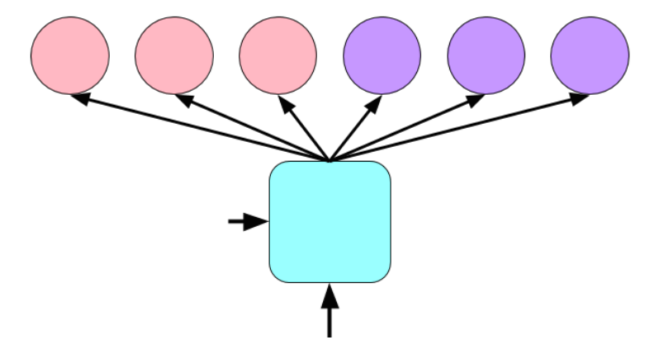
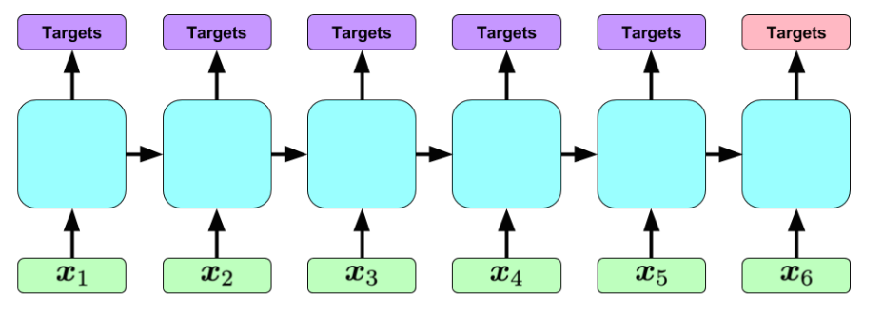
Notes:
Top 6 diagnoses ->

Slide 33
General Problem Statement
Predict PICU diagnoses days/weeks before they happen
Technical Problem Statement
Multi- single class classification of time series data using LSTM model, compare to existing models
Data | Loss
10, 401 PICU episodes, each a multivariate time series of 13 variables Single academic hospital PICU (LA Childrens) Scaling, imputing Output: diagnostic codes from hospital stay, as determined by physicians | We use log loss as the loss function at each output.
Network | Training
Last slide Recall that network allows us to maintain long-term time dependencies Regularization + Dropout | 100 epochs stochastic GD L2 regularization (prevent overweighting)
Notes:
Multi single as we can have multiple diagnoses
13 variables – is this a fair fight?

Slide 34
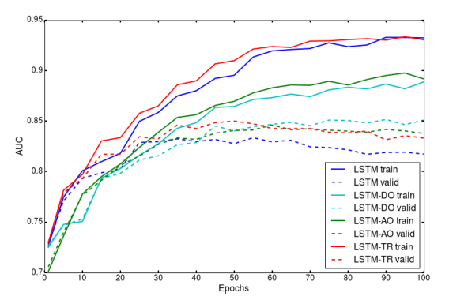
DO, TR, and AO indicate dropout, target replication, and auxiliary outputs, respectively
Notes:
Look at just dark blue -> audience participation, what’s going on

Slide 35
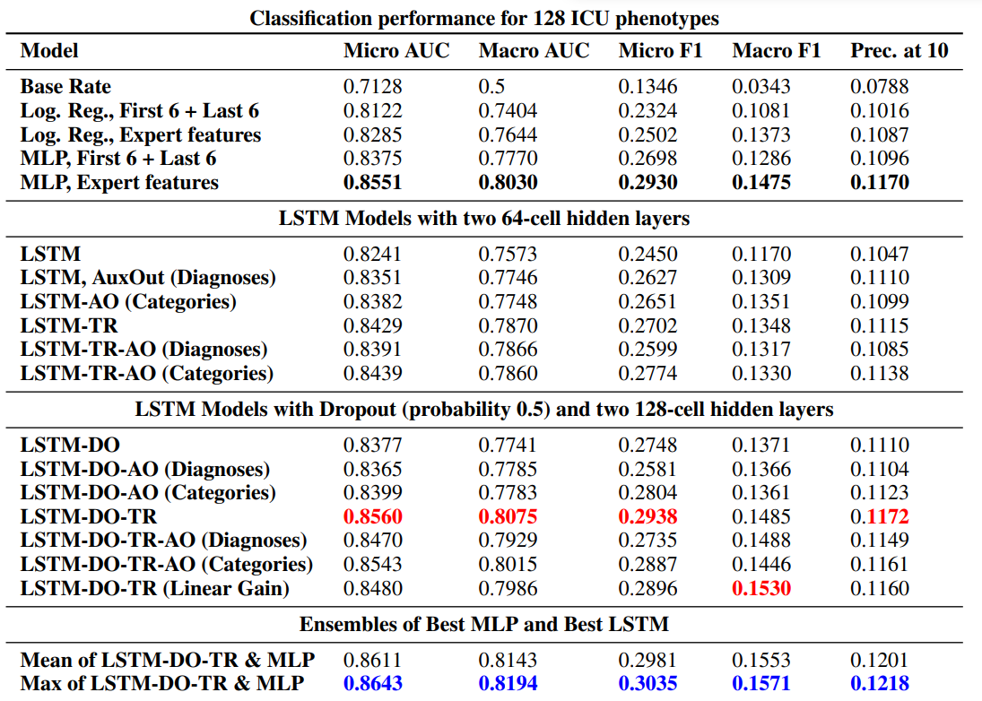
DO, TR, and AO indicate dropout, target replication, and auxiliary outputs, respectively
Notes:
New state of the art model at that time (barely, look at MLP)

